Slide 1
Investigating Racial and Economical Bias in Standardized Tests
Dana Hackel
General Assembly DSIR, Project 1
July 31, 2020

Slide 2
Key Terms
Bias – prejudice in favor
Socioeconomic Status – combination of person’s work experience and economic position
Title 1 School – receives financial aid from the Every Student Succeeds Act
>= 40 % low income students
Property tax funding is lower
Low Income Student – family income is in the lowest 20%
2018: $25,100 for a family of four

Slide 3
Background
Many colleges/ universities have faced lawsuits for the use of SAT and/or ACT scores for admissions
2015 analysis from ‘Inside Higher-ed’ (2400 SAT score)
Average reading score is 433 for with family income below $20,000
Average for reading score is 570 for those with income of above $200,000
2018
Combined scores for white and Asian students were above 1100
All other groups below 1000
Disclaimer: the bias holds against other standardized tests as well

Slide 4
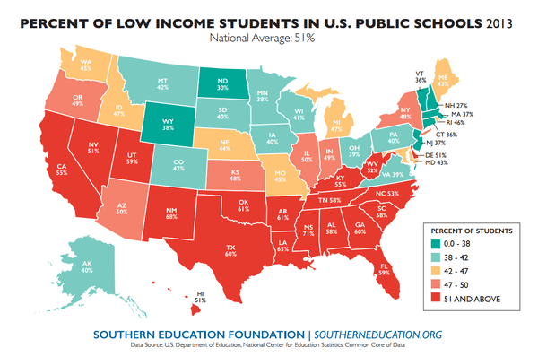
Mississippi – 71%
New Mexico – 68%
Louisiana – 65%

Slide 5
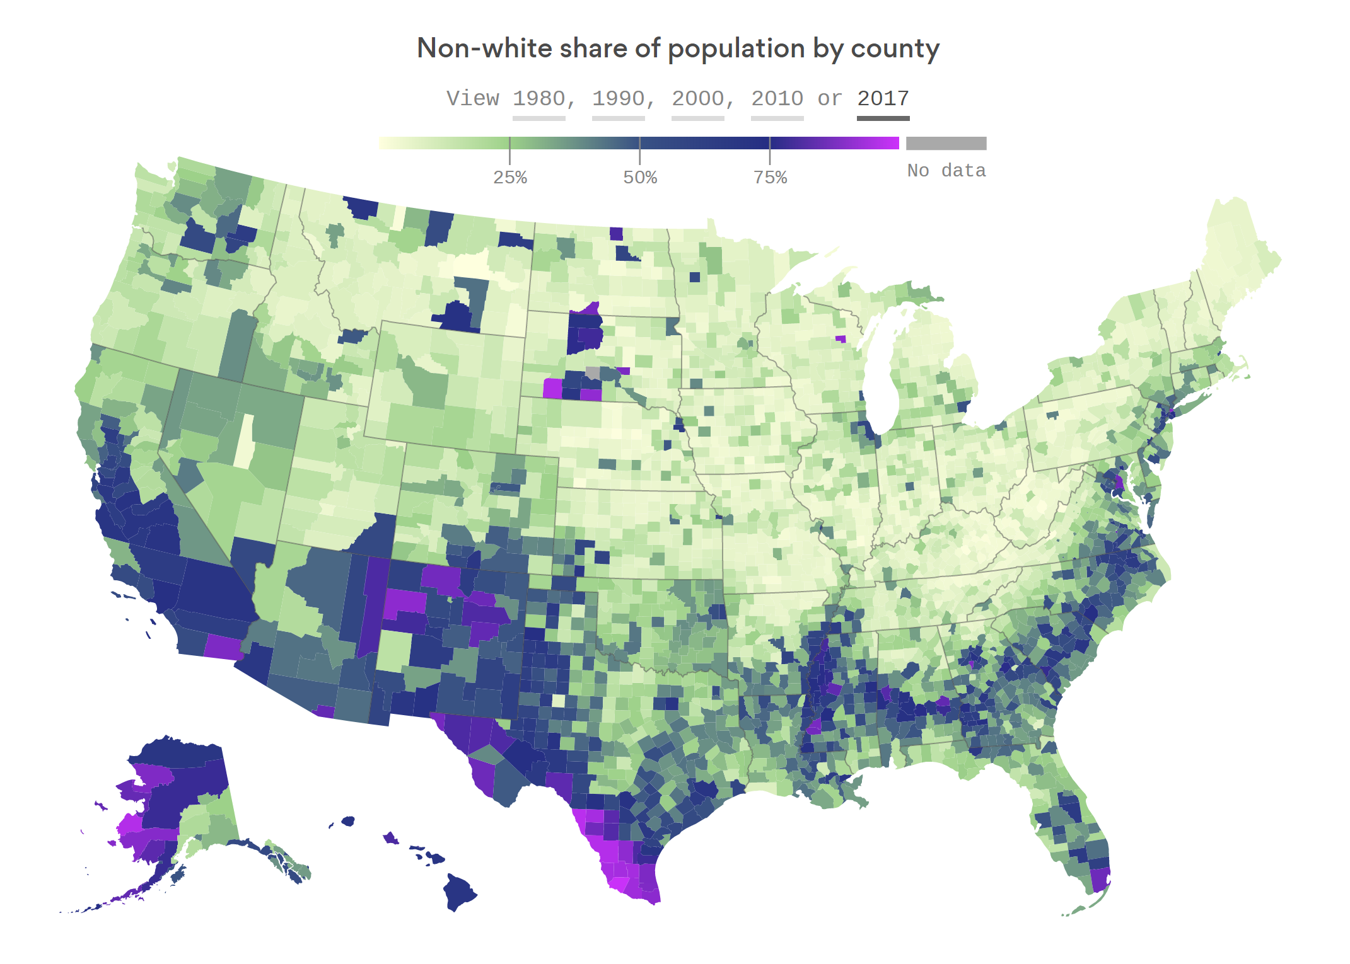
https://www.axios.com/when-american-minorities-become-the-majority-d8b3ee00-e4f3-4993-8481-93a290fdb057.html

Slide 6
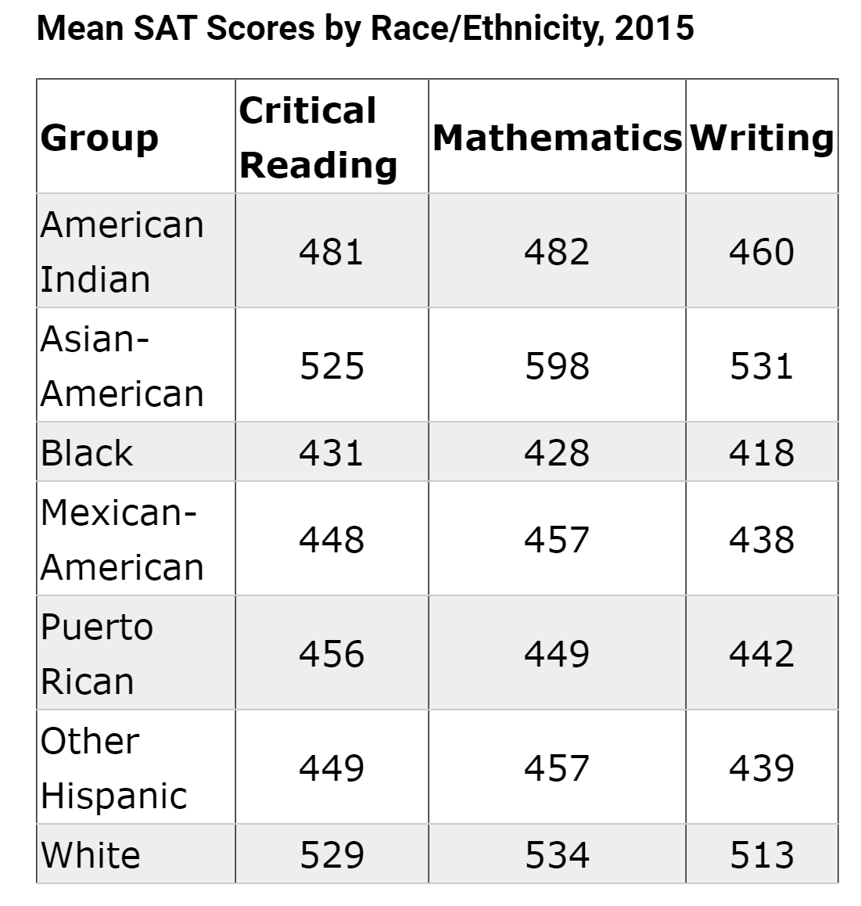
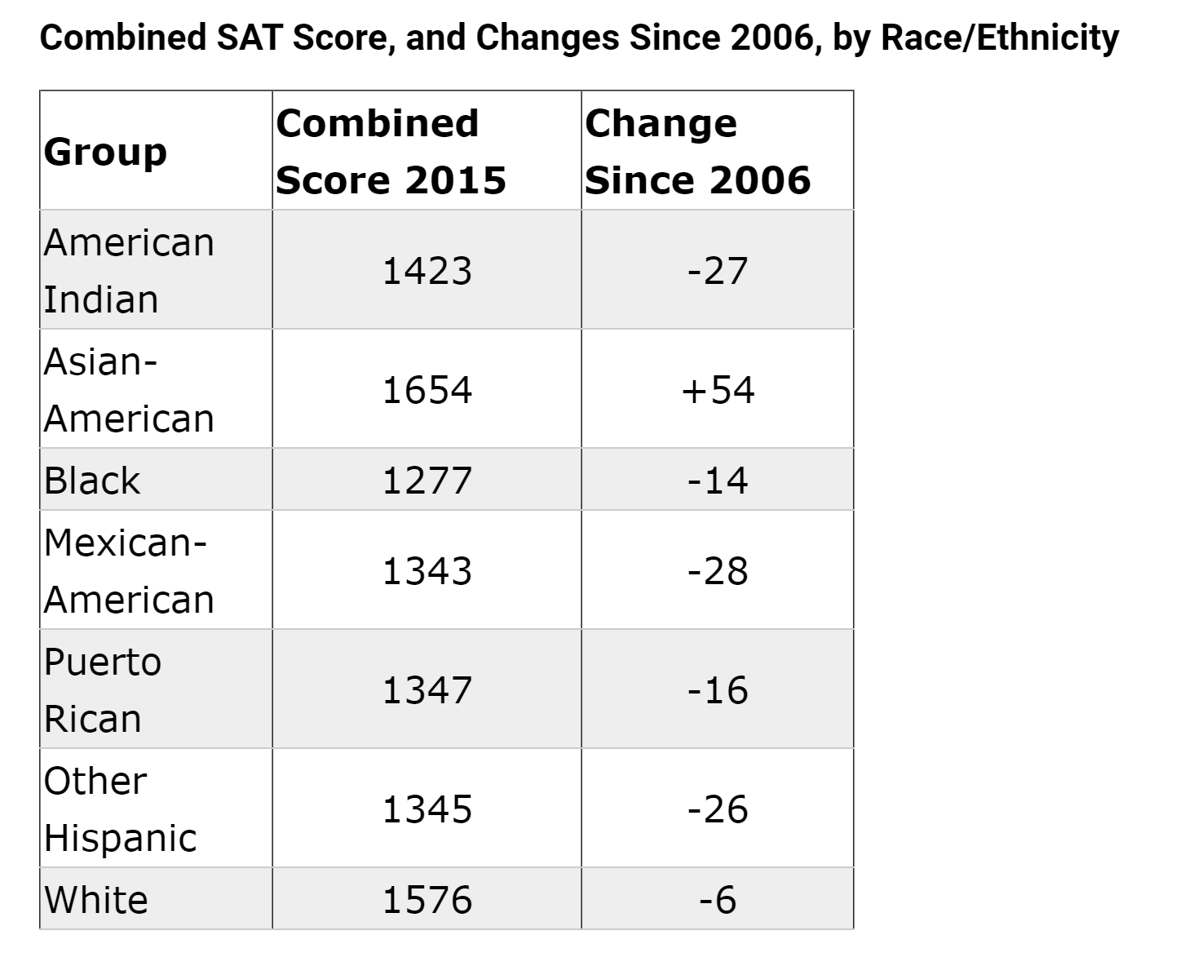
Figures from https://www.insidehighered.com/news/2015/09/03/sat-scores-drop-and-racial-gaps-remain-large

Slide 7
Methods
Analyzed data from all 50 states and District of Columbia
Cleaned data
Removed duplicates, fixed errors
Focused on MS, LA, NM

Slide 8
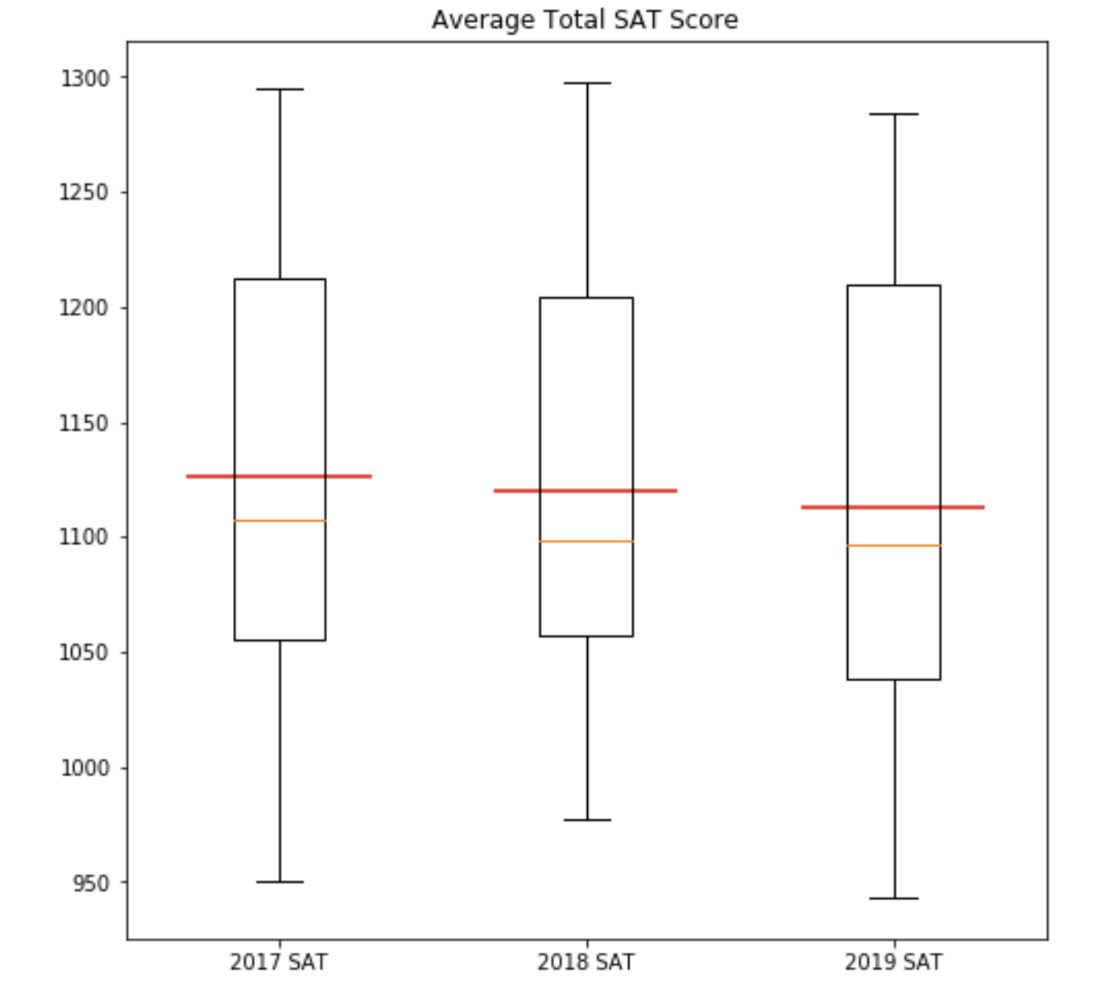
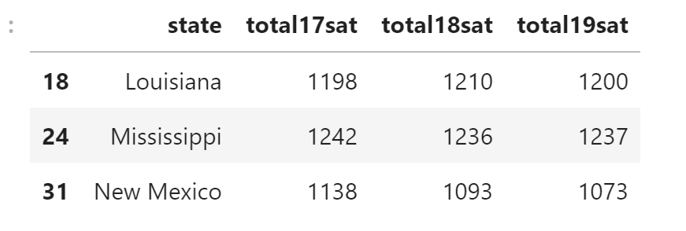
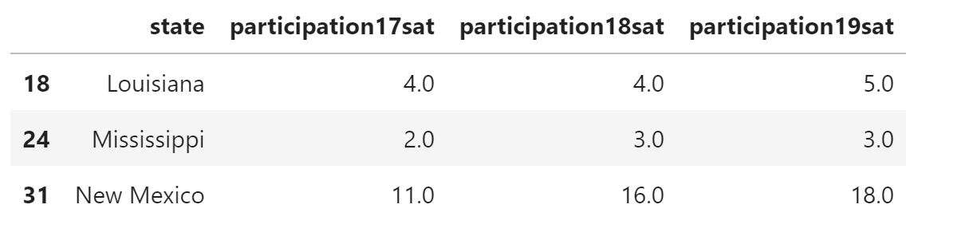
SAT Data Investigated

Slide 9
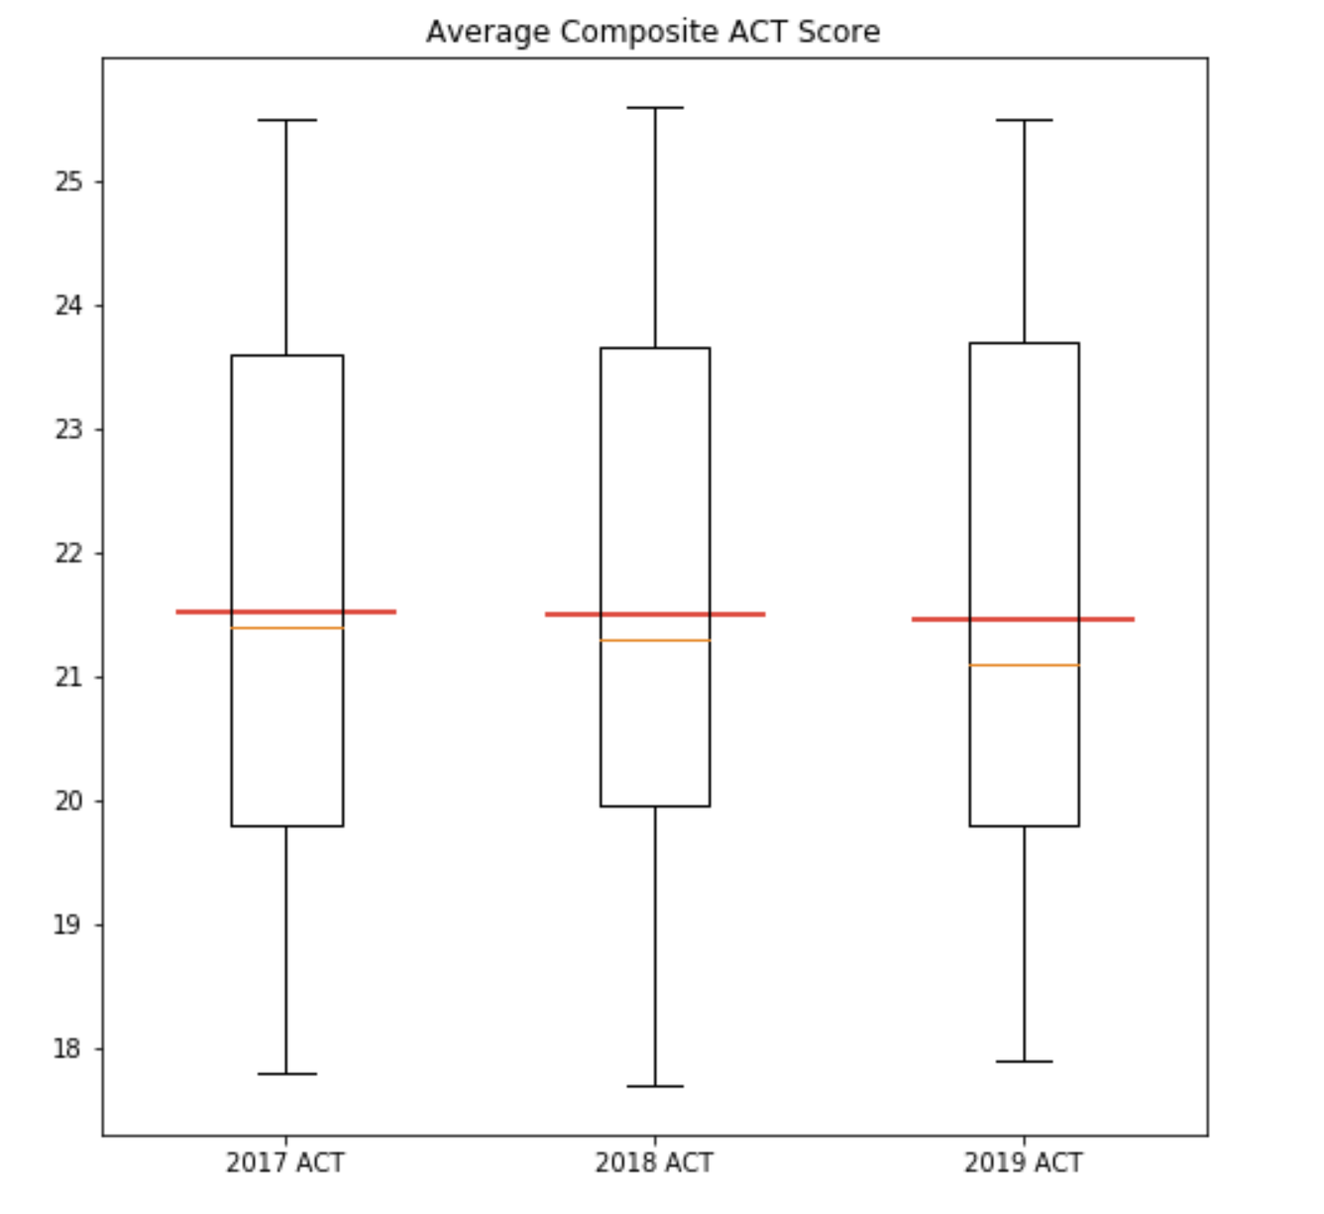
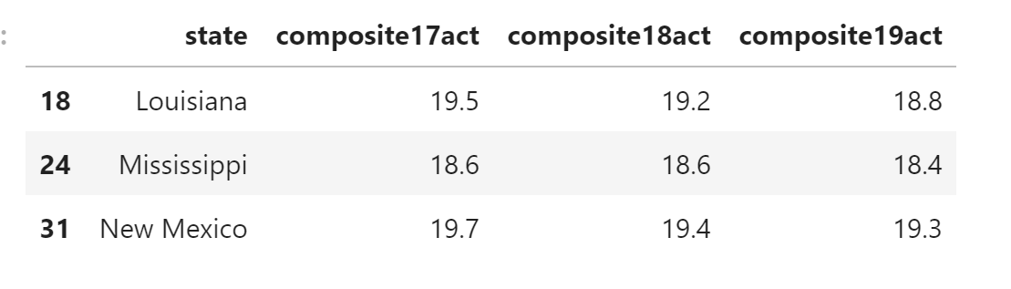
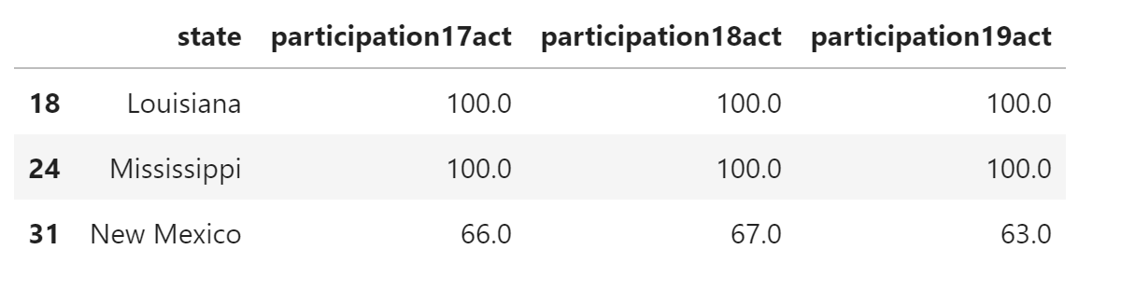
ACT Data Investigation

Slide 10
Insight
Low participation due to lack of funds and motivation
ACT for 2020-2021 starts at $55
Adds up with writing portion and score sending
Fee wavier - four tests, unlimited score reporting
SAT for 2019-2020 starts at $49.50
Fee waiver for two tests and unlimited reporting
Waived college application fees
Less access to prep programs
Forced participation targets this population of students
Unprepared, set up to fail

Slide 11
Recommendations and Future Directions
Investigate distribution of Title 1 schools in the US and compare that to state participation rates and scores
Offer test prep and funding for Title 1 schools
Title 1 does offer funding for AP exams
Don’t make the tests mandatory until preparation can be provided

Slide 12
References
https://www2.ed.gov/policy/elsec/leg/esea02/pg1.html
https://magoosh.com/hs/act/2017/states-that-require-the-act-or-sat/
https://www.insidehighered.com/news/2015/09/03/sat-scores-drop-and-racial-gaps-remain-large
https://blog.collegeboard.org/how-much-does-sat-and-sat-subject-test-cost#:~:text=For%20the%202019%2D2020%20school,an%20administration%20via%20the%20waitlist.
https://collegereadiness.collegeboard.org/sat/register/fees/fee-waivers
http://www.act.org/content/act/en/products-and-services/the-act/registration/fees.html

